Slide 1
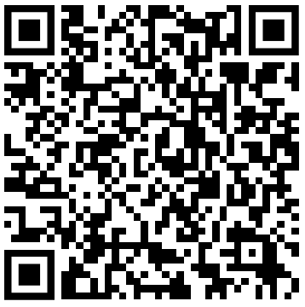

IE0005 Review
Attendance QR code
(physical & Zoom)
Start at 19:05!
Agent, Search, Constraint,
Game Playing, Reinforcement Learning

Slide 2
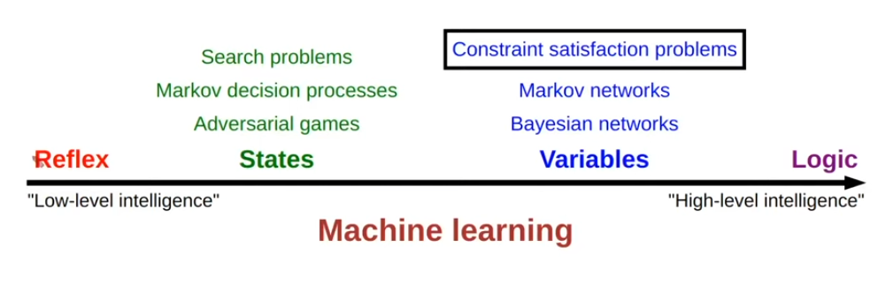
Content
Agent and Environment
Search
Constraint Satisfaction & Game Playing
Reinforcement Learning
Legend:
Core idea (for quiz)
Extra insights
Stanford AI: https://www.youtube.com/playlist?list=PLoROMvodv4rOca_Ovz1DvdtWuz8BfSWL2

Slide 3
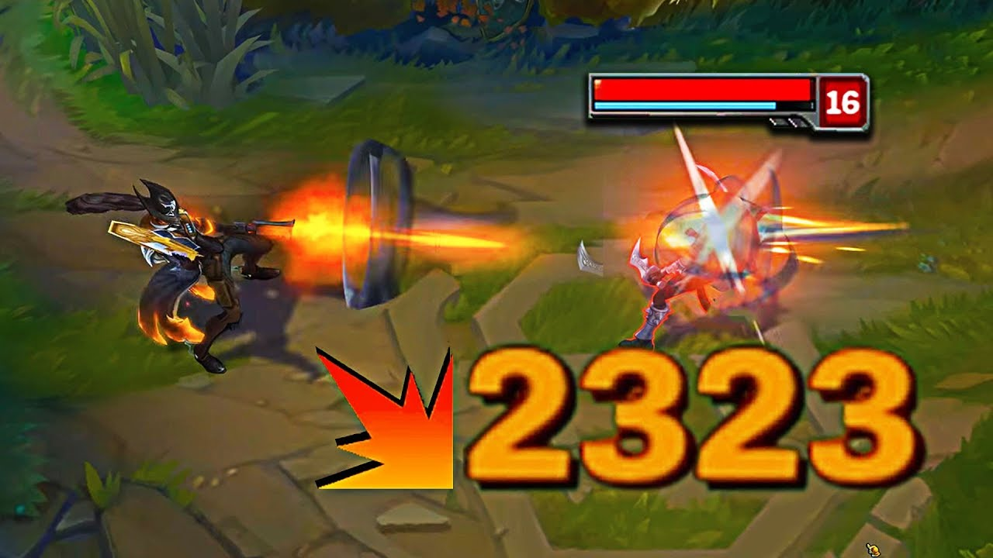
Agent & Environment
Accessible (Full knowledge) | Knowledge of the environment | Inaccessible (Partial knowledge)
Deterministic (No) | Consequence of action or state change has a probability distribution? | Non-deterministic (Yes, have distribution)
Episodic | Previous action/perception affect the next? | Sequential
Static | Changing environment | Dynamic
Discrete | State and Action data type | Continuous
Non-deterministic example
Critical hit
Dynamic example
Agent deliberation at 10 Hz
Environment changes at 20 Hz

Slide 4
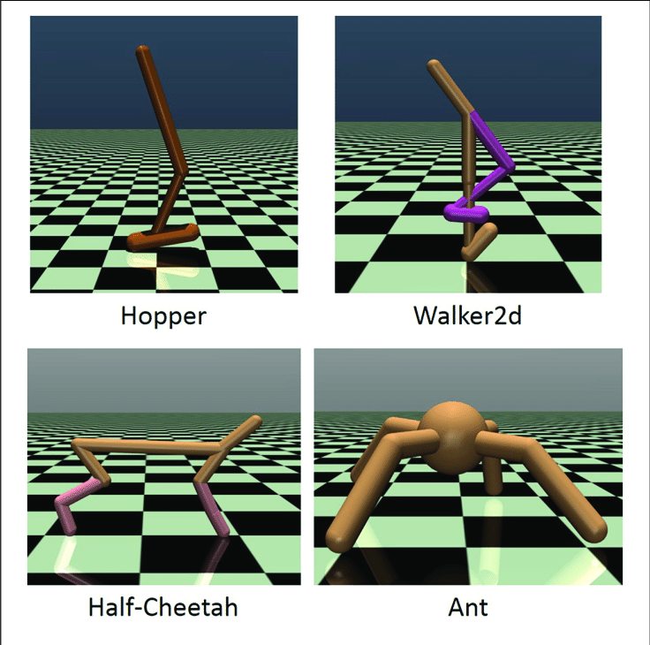
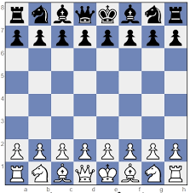
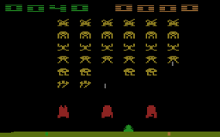
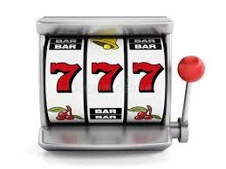

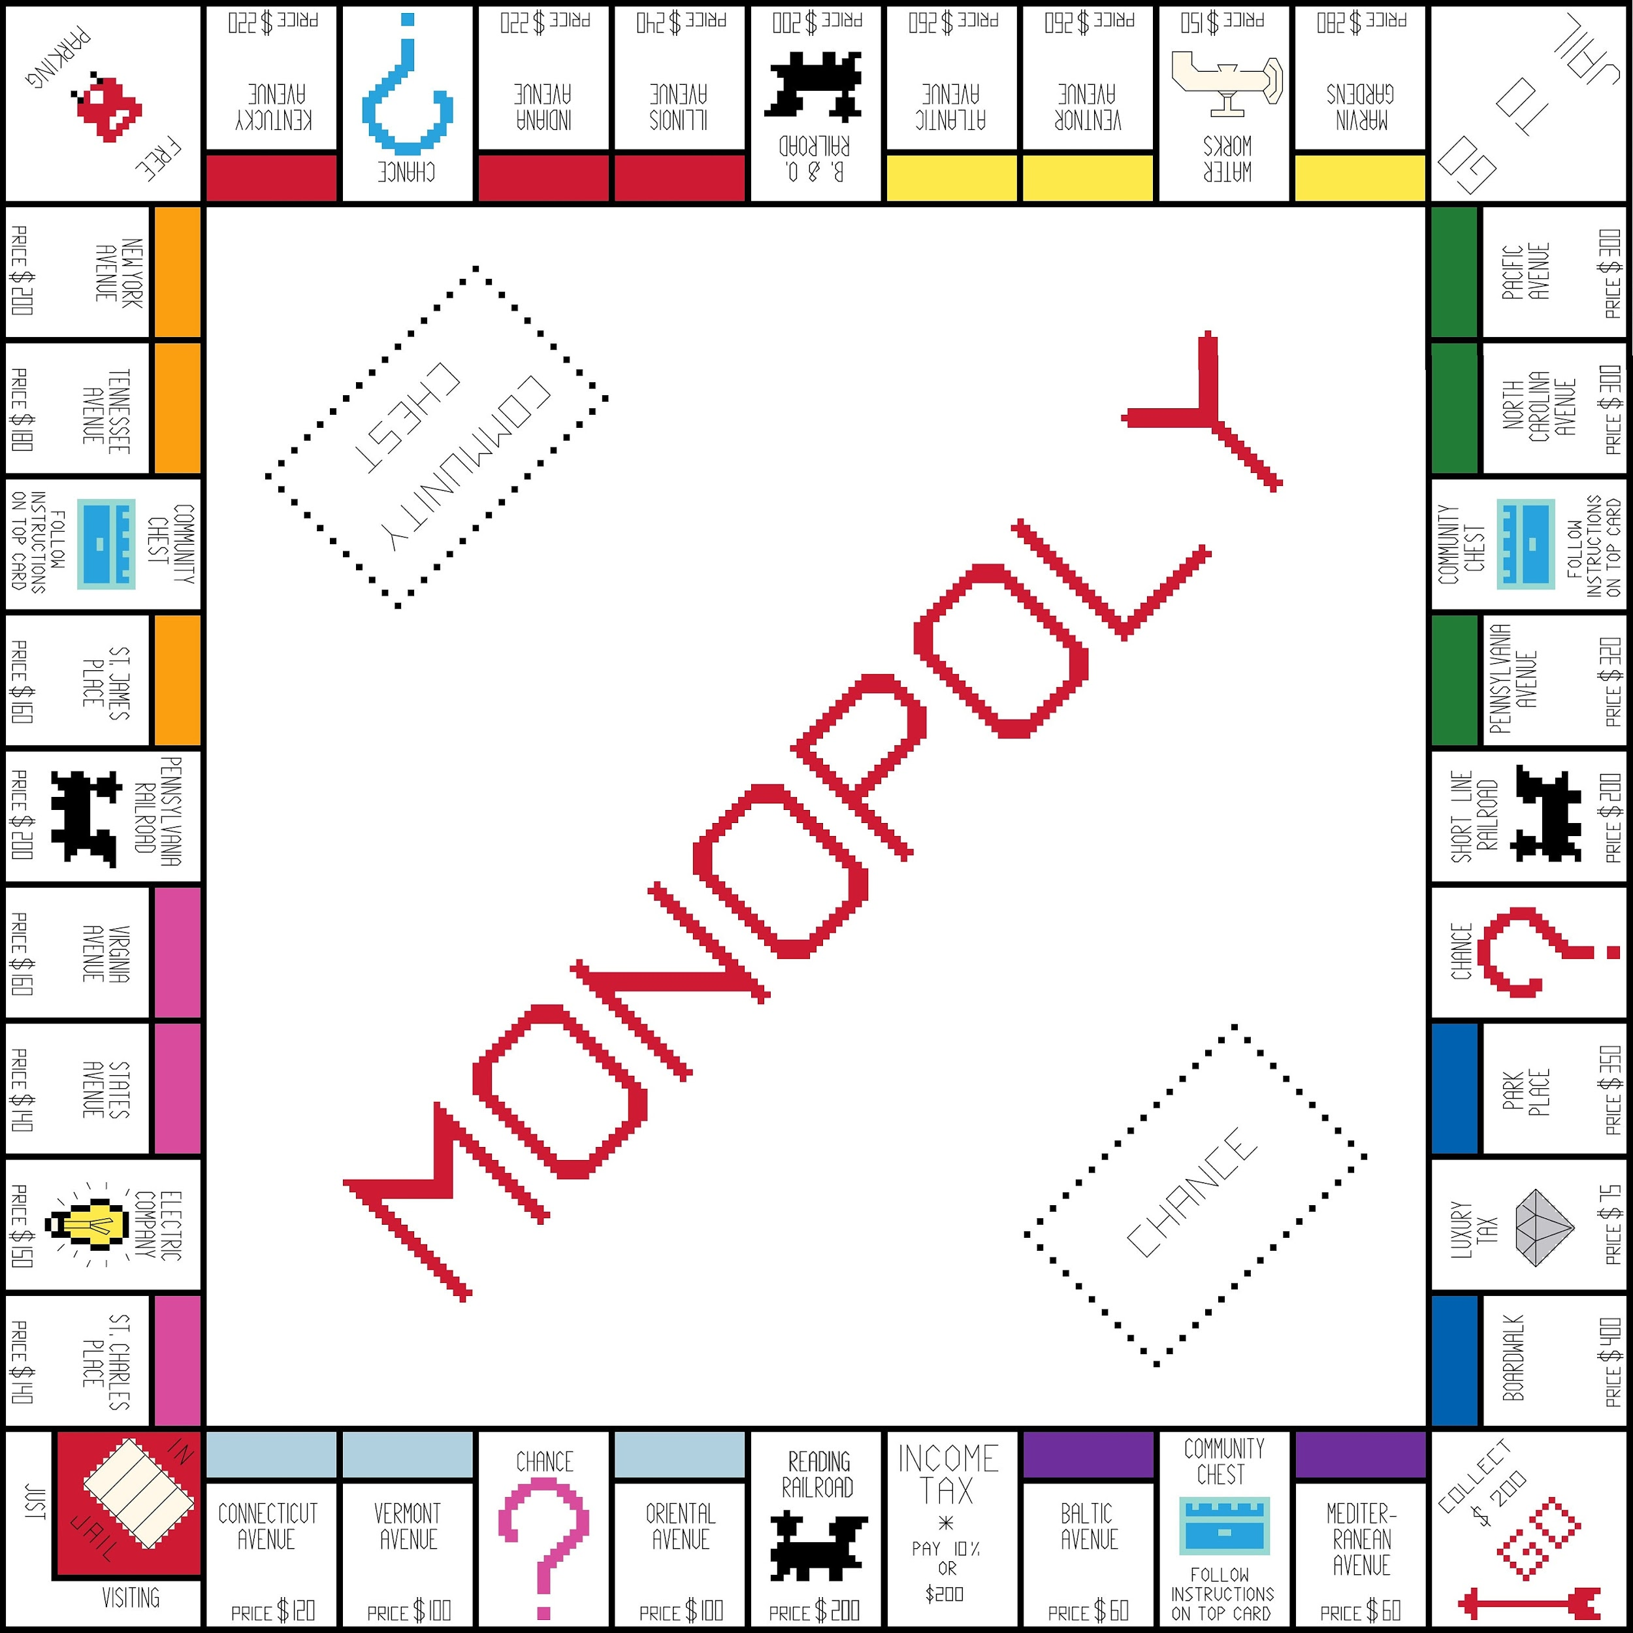
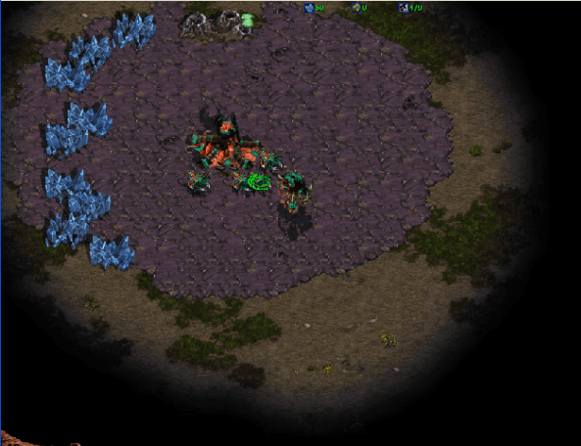
Agent & Environment
Accessible | Inaccessible
Deterministic | Non-deterministic
Episodic | Sequential
Static | Dynamic
Discrete | Continuous
Chess
Space Invader
Walking bot simulation
Slot Machine
Pong
Monopoly
Starcraft

Slide 5
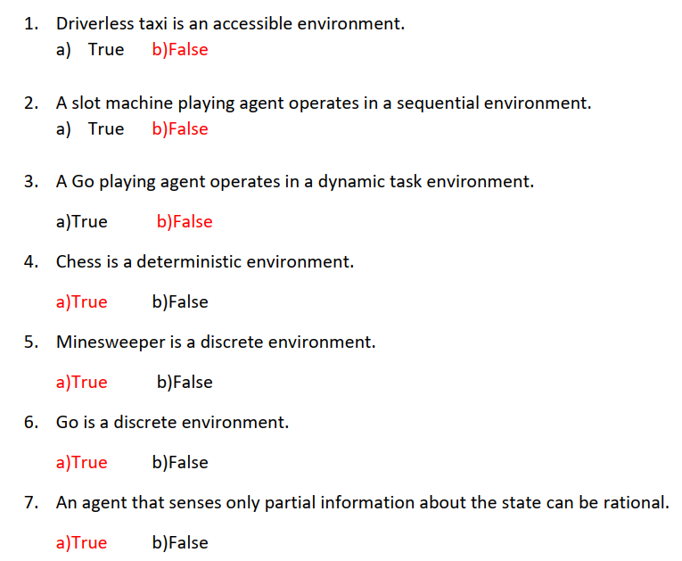
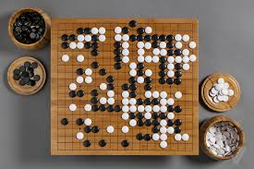
Questions
Accessible | Inaccessible
Deterministic | Non-deterministic
Episodic | Sequential
Static | Dynamic
Discrete | Continuous
Go

Slide 6
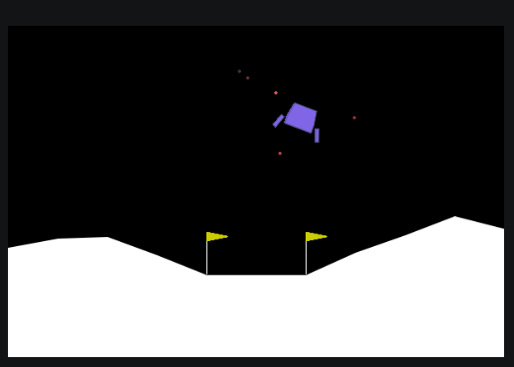
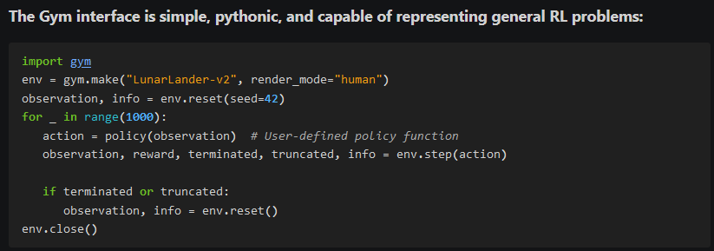
Agent & Environment
Why the “Agent and Environment” formulation?
Separate the “Agent logic” and “Environment logic”
Environment logic can be simple (If/else tree) or complex (simulations with physics)
Different agent logic can operate on the same environment. Agent logic developed for 1 environment might not be transferable
Environment logic
Agent logic / Policy
OpenAI Gym: https://www.gymlibrary.dev/index.html

Slide 7
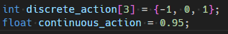
Agent & Environment
Why the different classifications?
Different classifications have different information to be utilized
Full knowledge: find the optimal outcome
Partial knowledge: find the best guess at the moment
Allow us to program the agent logic, assign variables, correctly
Correct data type (discrete, continuous)

Slide 8
Search
Un-informed Blind Search
Breadth-First Search (BFS): Uniform Cost search
Depth-First Search (DFS):
Depth-Limited Search (DLS)
Iterative-Deepening Search (IDS)
Informed Search
Greedy Search: Heuristic
A* Search: Heuristic and path cost

Slide 9
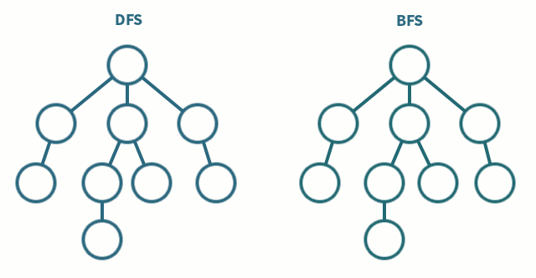
Search: Blind Search (BFS, DFS)

Slide 10
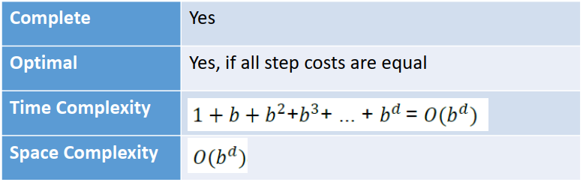
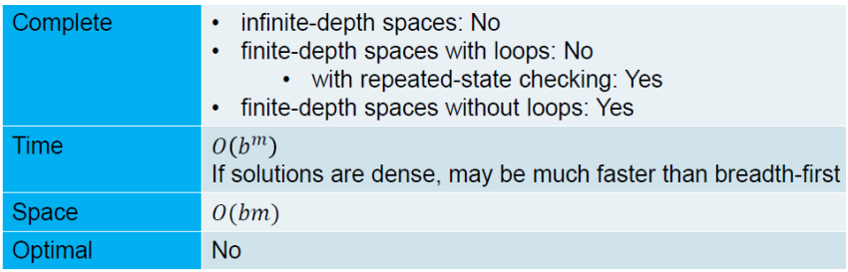
Search: Blind Search (BFS, DFS)
b: branching factor
d, m: max depth (goal depth)
BFS
Worst case
2^3
DFS
Goal
Worst case
2*3
Currently checking this node

Slide 11
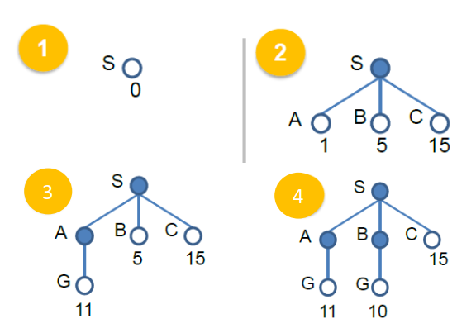
Search: Blind Search (Uniform Cost)
Weighted graph
Depth-first search until the depth is not as good as the next best breadth
Keep track of the path cost
Note: Sometimes they give weighted graph, but ask for PURE BFS, DFS

Slide 12
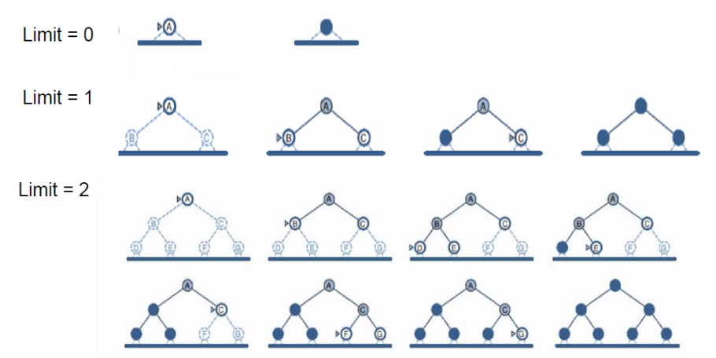
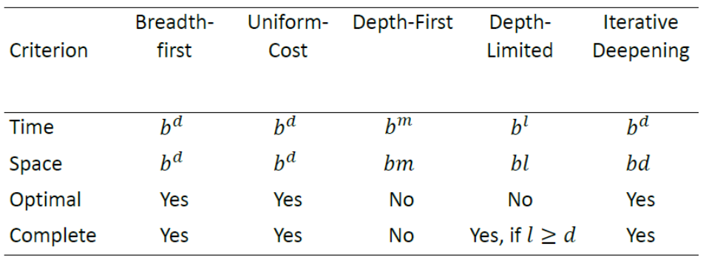
Search: DLS, IDS
b: branching factor
d, m: max depth (goal depth)
l: limited depth

Slide 13
Search: Informed Search
Blind search expands the search from the source in all directions
Only know it is the goal when it reaches the goal
Informed Search has another information to measure the “distance/ farness” from source to the goal
Keep track of the “desirability/score/utility” of each node
Uniform-cost Search: Path cost only
Greedy Search: Heuristics only
A* Search: Heuristics + Path

Slide 14
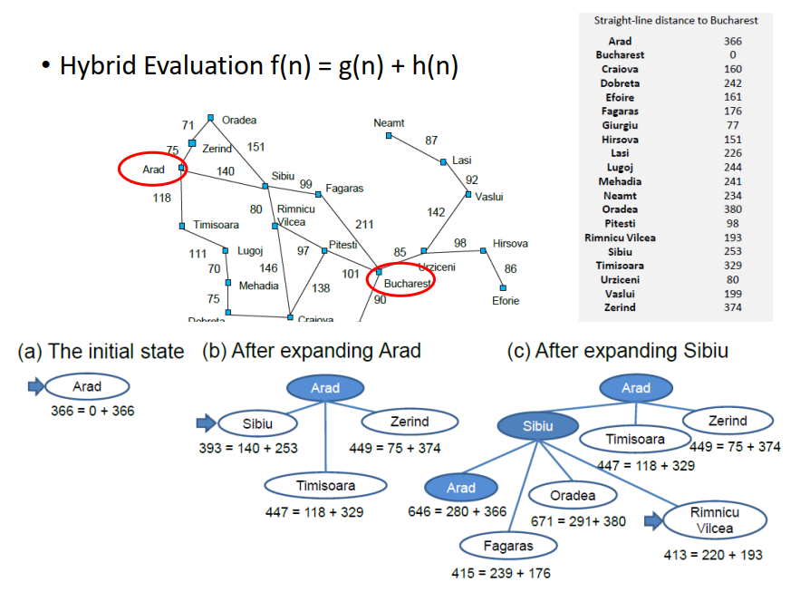
Search: Informed Search

Slide 15
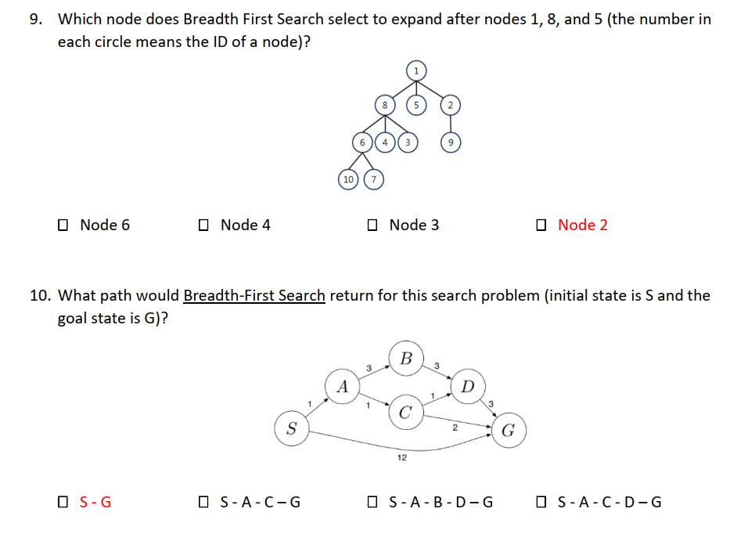
Question
Node 6 b) Node 4 c) Node 3 d) Node 2
S,G b) S, A, C, G c) S,A,B,D, G d) S, A, C, D,G

Slide 16
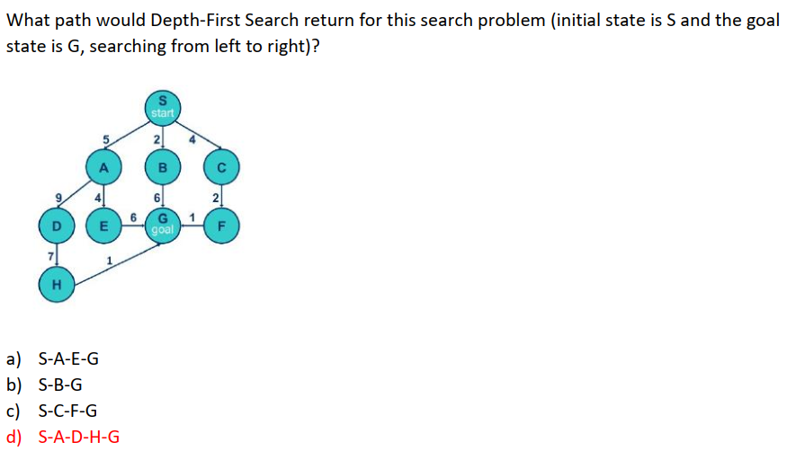
Question
S, A, E, G
S, B, G
S, C, F, G
S, A, D, H, G

Slide 17
Search: Graph (Data Structure & Algo)
1
2
3
4
5
6
7
Graph
Root node, Parent nodes, Children node
Order
First-in-First-Out Queue
Last-in-First-Out Stack
Keep track of the nodes values with arrays
Shortest-path from node A to B in a known weighted graph: Dijkstra’s Algo
7
6
5
4
4
2
3
2
1
1
BFS Queue
DFS Stack

Slide 18
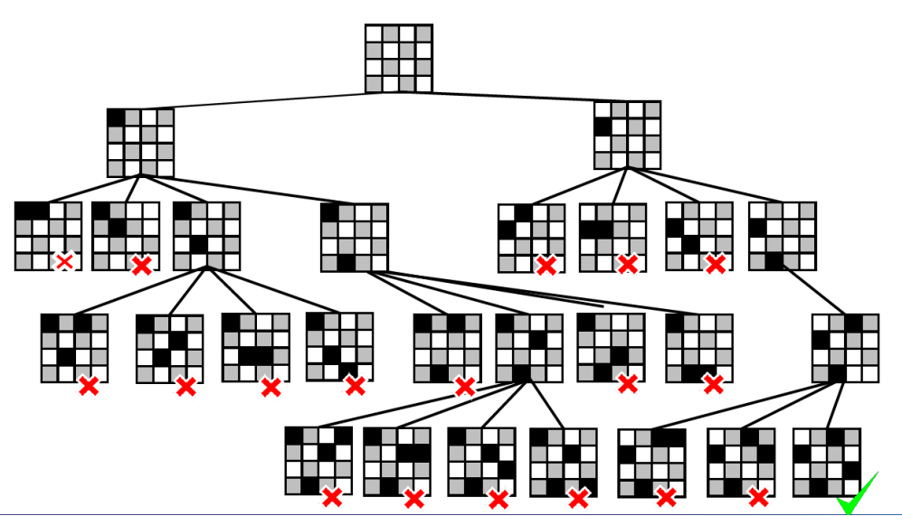
Constraint Satisfaction
Terminology:
Variables
Variables have values
Objective:
Find a set of values for variables that satisfied constraints
Need not be unique
Backtracking:
Depth first search
With constraint checking
Forward Checking,
Constraint Propagation

Slide 19
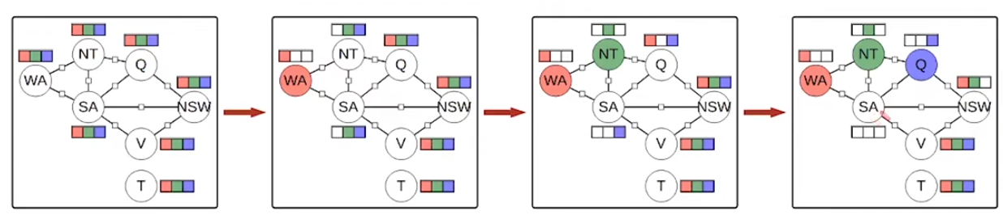
Constraint Satisfaction
Terminology:
Variables
Variables have values
Objective:
Find a set of values for variables that satisfied constraints
Need not be unique
Backtracking:
Depth first search
With constraint checking
Forward Checking,
Constraint Propagation

Slide 20
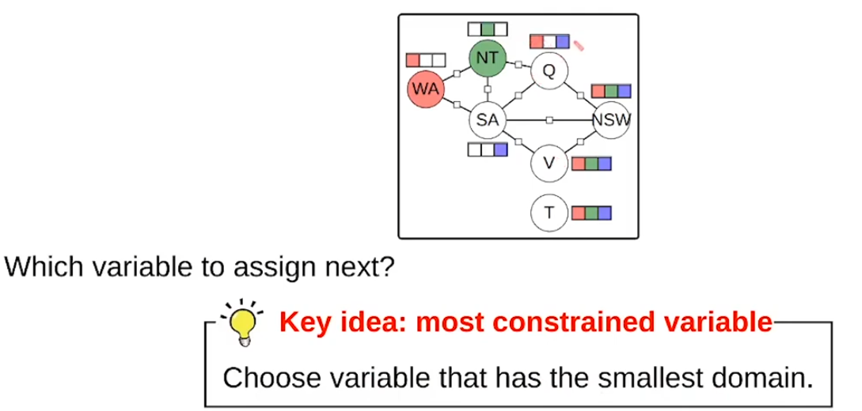
Constraint Satisfaction
Which variable to allocate first?

Slide 21
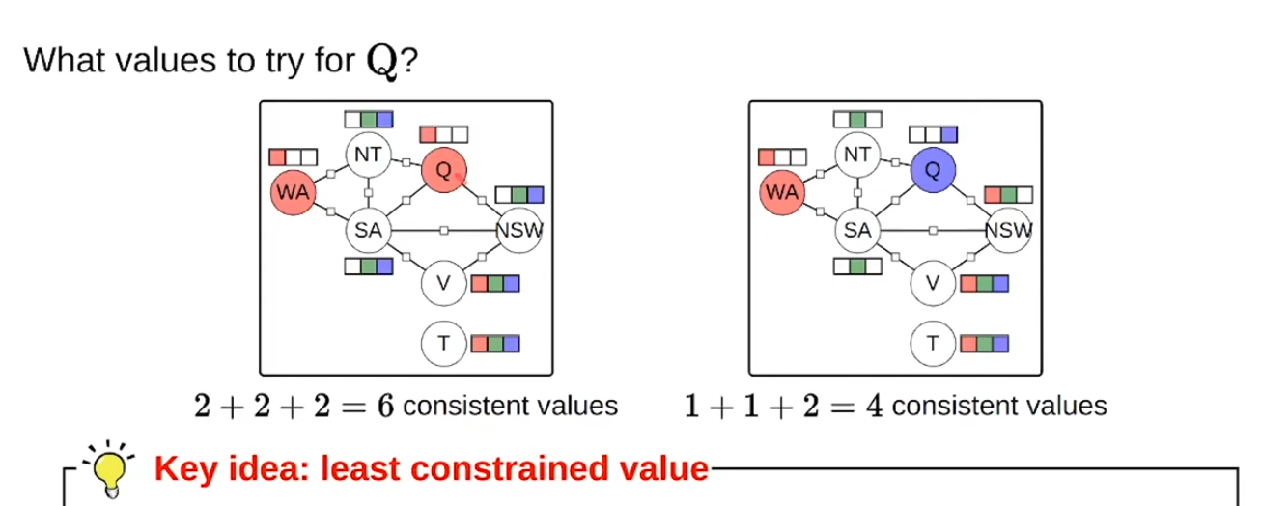
Constraint Satisfaction
Which value to allocate for Q first?

Slide 22
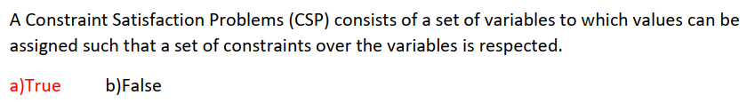
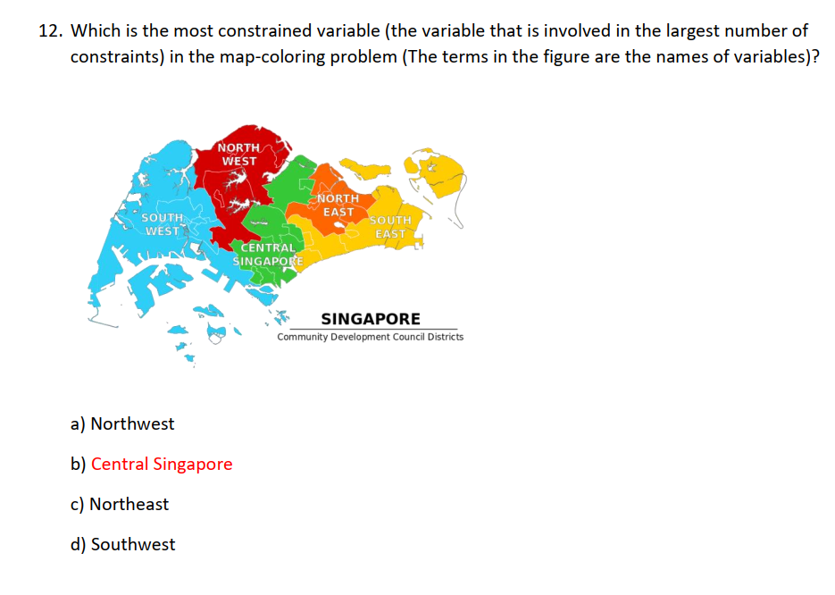
Question

Slide 23
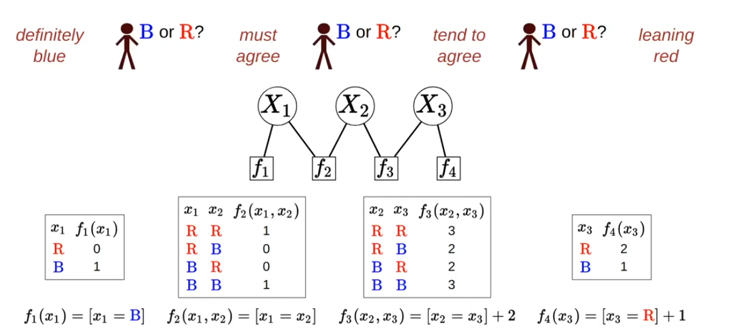
Constraint Satisfaction
Factor Graph
Variables having values
Constraint function/factor

Slide 24
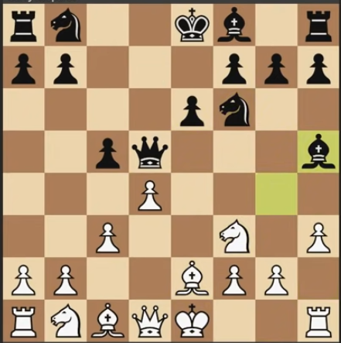
Game Playing: Minimax
Have a function to calculate the utility/score at the current state of the game
The utility score favor us
We want to maximize, the opponent want to minimize
Propagate UP from the bottom nodes
Challenges: needs to evaluate all the way to the endgame. Not feasible!
https://www.youtube.com/watch?v=l-hh51ncgDI

Slide 25
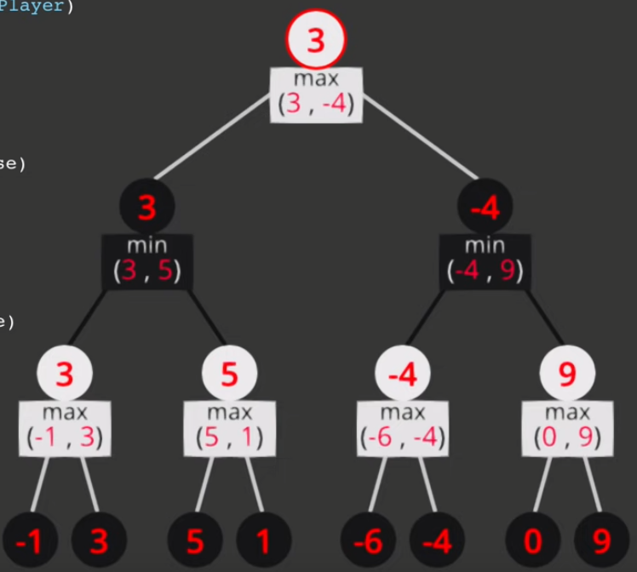
Game Playing: Minimax
You can calculate the “score” of any state
You can look ahead some step and know their utility
What is your current utility? What should you do?

Slide 26
Game Playing: Minimax
3
max
<= 2
3
min
5
3
2
X
5
2
3
1
1
2
X
X

Slide 27
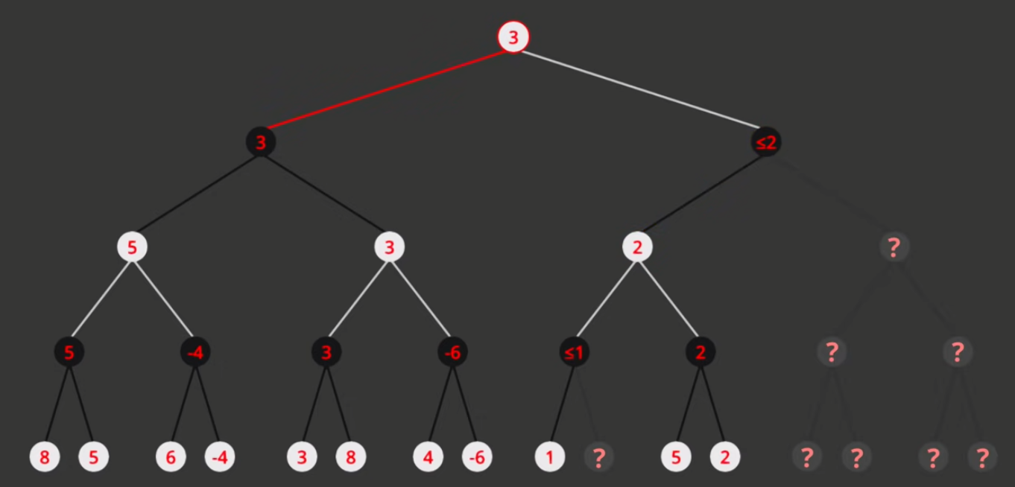
Game Playing: Pruning
Agent does not need to evaluate all possibilities. Can use pruning
https://www.youtube.com/watch?v=l-hh51ncgDI

Slide 28
Game Playing: Minimax
7
max
2
7
min
2
8
7
9
1
2
5
8
6
7
7
9

Slide 29

Reinforcement Learning
State, Action, Reward
Expected Utility
Utility, Bellman Equation
OBJECTIVE
Maximize the reward received as the agent operate in the environment (from start to end/goal state)

Slide 30
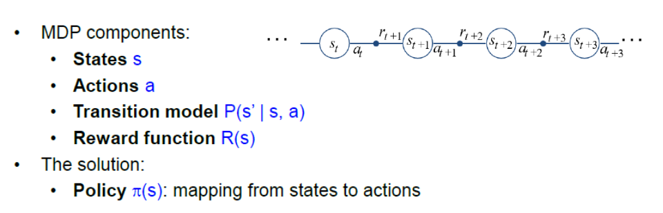
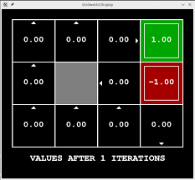
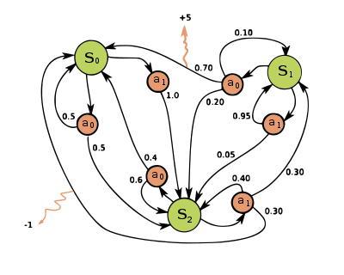
Markov Decision Process

Slide 31
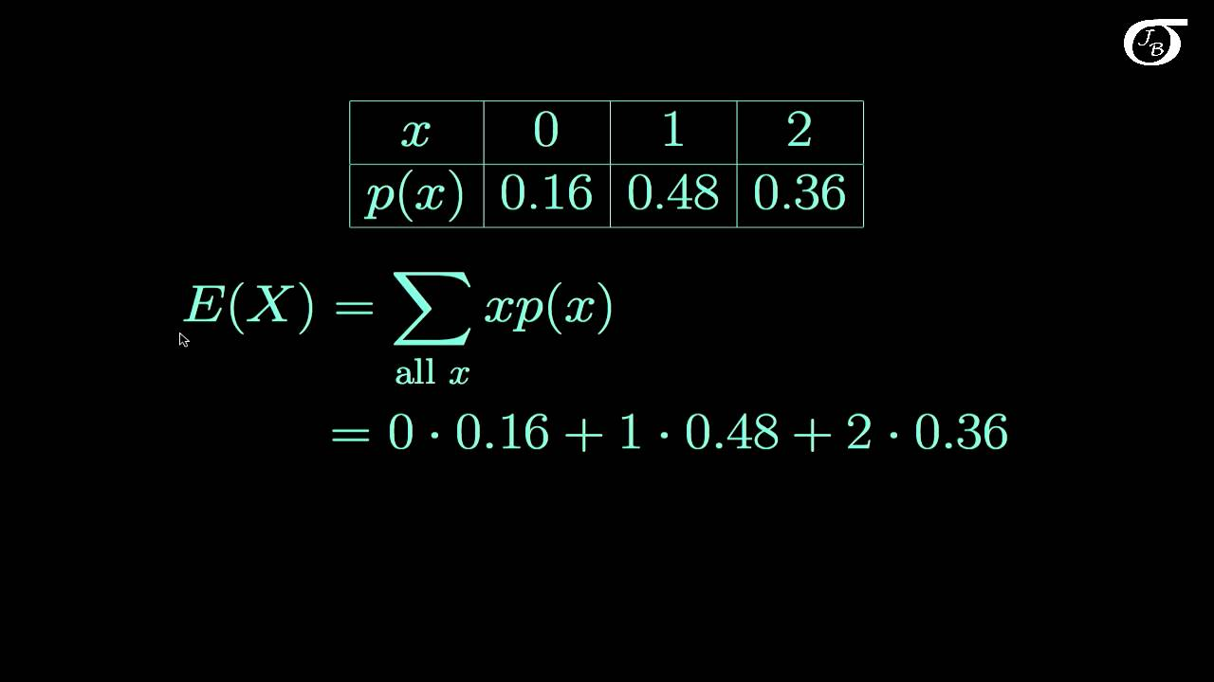
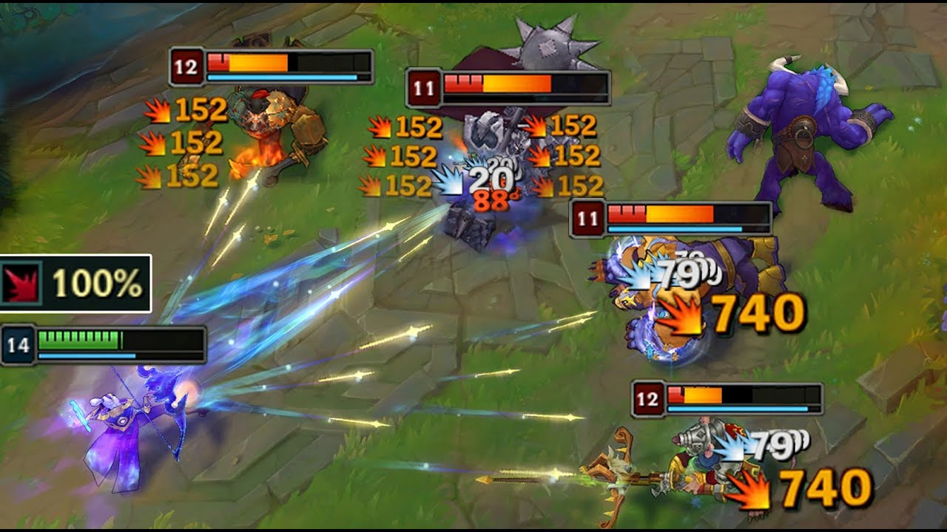
Expected Utility
https://www.youtube.com/watch?app=desktop&v=OvTEhNL96v0
Recall your statistics and probability
It is just calculating the “Mean”, “Expected Value”
p=0.2
Why the distribution? Non-deterministic, probabilistic action and state transitions.
s1
20
a1
p=0.8
s2
10
Expected utility of action “a1” = 8+4 = 12

Slide 32
More calculation
p=0.1
s2
120
p=0.2
a1
Expected utility of state “s1” = 0.2 (12+18) + 0.8 (20+30)
= 0.2 * 30 + 0.8 * 50
= 6 + 40
= 46
s3
20
s1
p=0.9
p=0.5
s4
40
p=0.8
a2
s5
60
p=0.5
Probabilistic
Action policy

Slide 33
More calculation
p=0.1
s2
120
a1
a1 vs a2
(12+18) vs (20+30)
30 vs 50
s3
20
s1
p=0.9
p=0.5
s4
40
a2
s5
60
p=0.5
Deterministic policy
Choose the better action

Slide 34
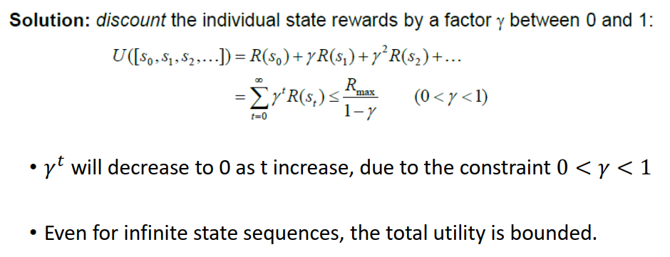
Discounted Utility
100 SGD
100 SGD
Now
1 year
Future reward is discounted

Slide 35
Intuitive idea of Utility
No history of previous states
If you reach the same state, you will see the same “state”, same set of actions, have the same set of transition probability
Question: If you are to redo your University, you don’t remember anything that you have done, what would you choose?
CS
Memory wipe
Got into Uni
EEE

Slide 36
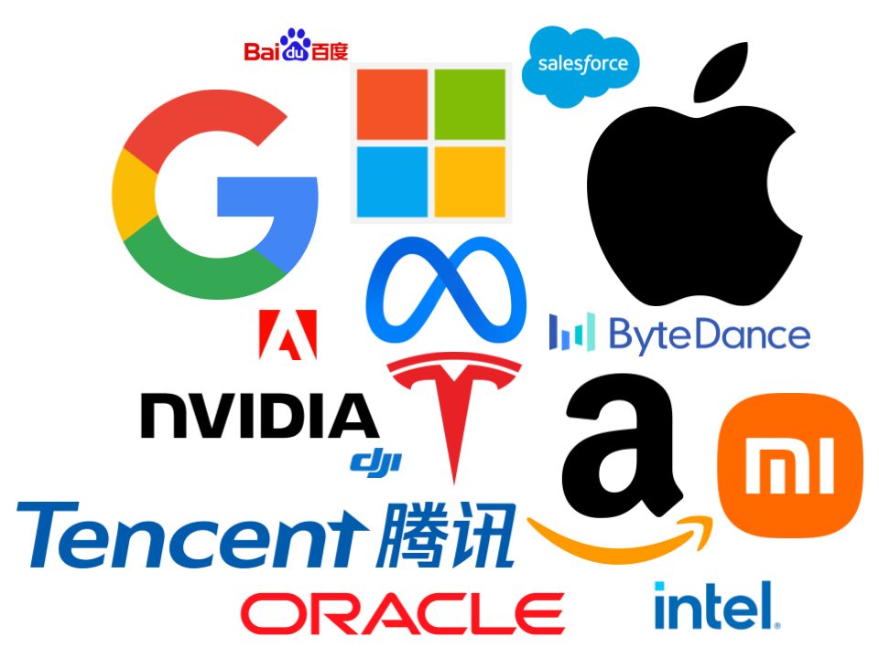
Intuitive idea of Utility
The Utility encapsulates the “desirability” toward the goal.
Agent can only observe the current and the possible transitions to the next state
s2
…
s1
Goal
s3
What the agent can observe. How to know which state to go?
CS
Memory wipe
Got into Uni
…
Goal:
Get money
EEE
What is a potential Utility?
Expected Salary

Slide 37
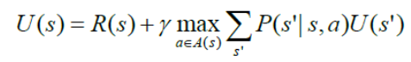
Bellman Equation
Discounted Coefficient
Expected Value
Next action
transition probability
Next State Utility
Current State
Utility
Current State
Reward
Take action that get maximum expected value

Slide 38
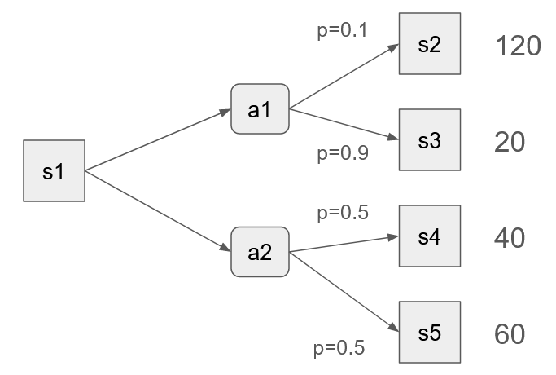
Bellman Equation
Discounted Coefficient
Expected Value
Next action
transition probability
Next State Utility
Current State
Utility
Current State
Reward
Take action that get maximum expected value
The point?
Propagate the utility score to states that are further away from the goal
Why take max of expected value?
Probabilistic state transition. You want to take an action, but life hits you in the face
Take max because we want to reach the goal, have the best utility

Slide 39
5
10
Gamma = 0.5
Reward = 5
A2 = 10
A1
= Pa1 * Ua1 = 0.5*19
= 9.5
p =0.1
S2
100
p =0.5
A2
= Pa2 * Ua2 = 0.5 * 20
= 10
A1
S3
10
10
S1
p =0.9
A2
p =0.5
S4
20

Slide 40
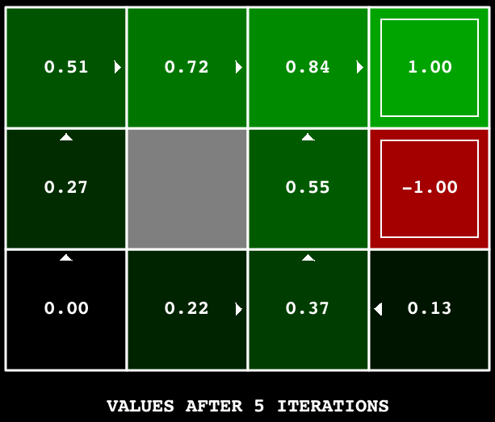
Value Iteration
Greedy Policy
Evaluate the Utility of all state
Pick the state with highest utility

Slide 41
Over time
1 run/episode
from start to end condition (might not be the goal)
1 run/trajectory
1 run/trajectory
…
“time”, “time step”

Slide 42
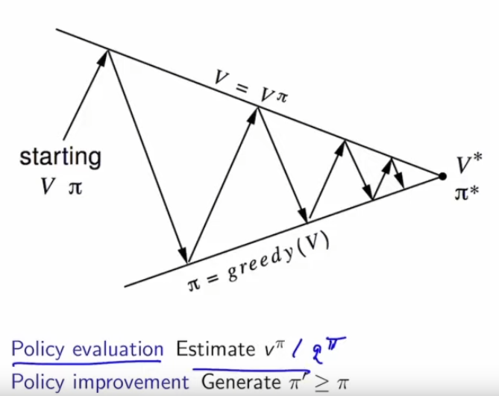
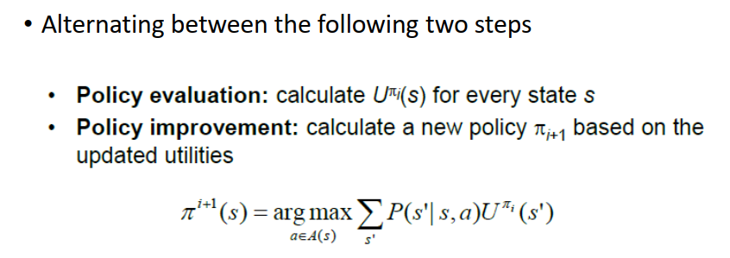
Policy Iteration
Agent has its own policy
Observing different states, the agent will give different action
Evaluate the current policy
Update the policy
Can be a look up table
Can be a function, mapping, neural network

Slide 43
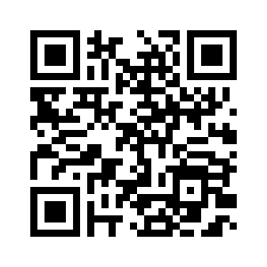
THE END
Feedback

